Slide 1
Application of NLP in Information Retrieval

Slide 2
Presentation Outline
Overview of current IR Systems
Problems with NLP in IR
Major applications of NLP in IR

Slide 3
Motivation
Most successful general purpose retrieval methods are statistical methods.
Sophisticated linguistic processing often degrade performance.

Slide 4
What is IR ??
“Information retrieval system is one that searches a collection of natural language documents with the goal of retrieving exactly the set of documents that pertain to a users question”
Have their origins in library systems
Do not attempt to deduce or generate answers

Slide 5


The problem of IR
Goal = find documents relevant to an information need from a large document set
Info. need
Query
Document
collection
IR system
Retrieval
Answer list

Slide 6
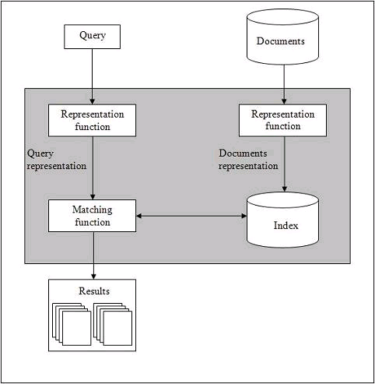
Basics of IR Systems

Slide 7
Basics of IR Systems (contd…)
Indexing the collection of documents.
Transforming the query in the same way as the document content is represented.
Comparing the description of each document with that of the query.
Listing the results in order of relevancy.

Slide 8
Basics of IR Systems (contd…)
Retrieval Systems consist of mainly two processes:
  Indexing
  Matching

Slide 9
Indexing
Indexing is the process of selecting terms to represent a text.
Indexing involves:
  Tokenization of string
  Removing frequent words
  Stemming (removing ing, ed, etc)
Two common Indexing Techniques:
  Boolean Model
  Vector space model

Slide 10
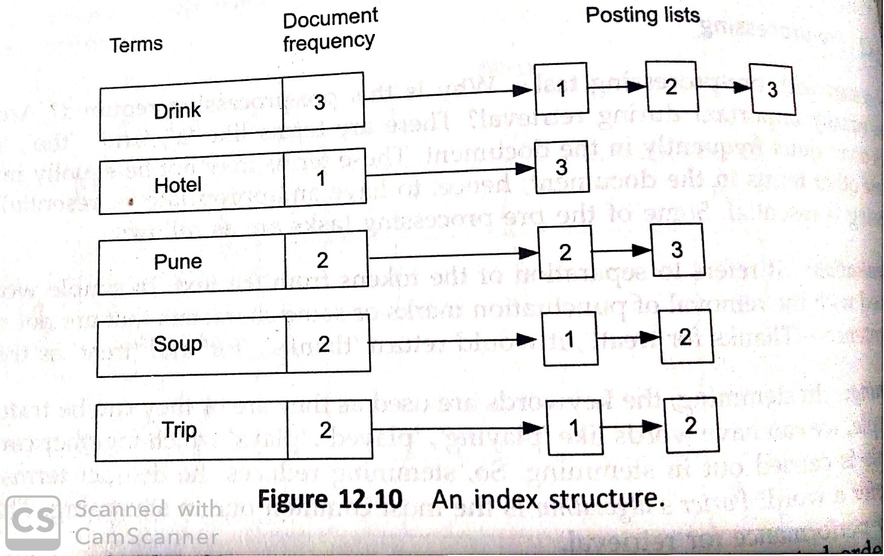
Indexing

Slide 11
Information Retrieval Models
A retrieval model consists of:
  D: representation for documents
  R: representation for queries
  F: a modeling framework for D, Q
  R(q, d_{i}): a ranking or similarity function which orders the documents with respect to a query.
  In this, tokens are treated in the form of 1’s and 0’s

Slide 12
Boolean Model
Queries are represented as Boolean combinations of the terms.
Set of documents that satisfied the Boolean expression are retrieved in response to the query.
Drawback
  User is given no indication as to whether some documents in the retrieved set are likely to be better than others in the set

Slide 13
Vector Space Model
In this model documents and queries are represented by vectors in T dimensional space.
T is the number of distinct terms used in the documents.
Each axis corresponds to one term.
Ranked list of documents ordered by similarity to the query where similarity between a query and a document is computed using a metric on the respective vectors.

Slide 14
Matching
Matching is the process of computing a measure of similarity between two text representations.
Relevance of a document is computed based on following parameters:
  tf - term frequency is simply the number of times a given term appears in that document.
  tf_{i.j} = (count of i^{th} term in j^{th} document)/(total terms in j^{th} document)
  idf - inverse document frequency is a measure of the general importance of the term
  idf_{i} = (total no. of documents)/(no. of documents containing i^{th} term)
  tfidf_{i,j} score = tf * idf

Slide 15
Evaluation of IR Systems
Two common effectiveness measures include:
  Precision: Proportion of retrieved documents that are relevant. (it is near to accuracy)
  Precision= no. of retrieved relevant documents/total no.of relevant documents
  Recall: Proportion of relevant documents that are retrieved.
  Recall= no. of retrieved relevant documents/total no.of retrieved documents
Ideally both precision and recall should be 1.
In practice, these are inversely related.

